Slide 1
Identifying Differentially Regulated Liver Genes in Naked Mole Rat Population
Phoebe Fei, Apr. 25th, 2022
CMPB 5004 Final Presentation

Slide 2
Outline
Introduction
Background
Data and Question
Methods
Workflow
Results
Conclusion & Discussion
Reference
Extra Slides / Figures

Slide 3
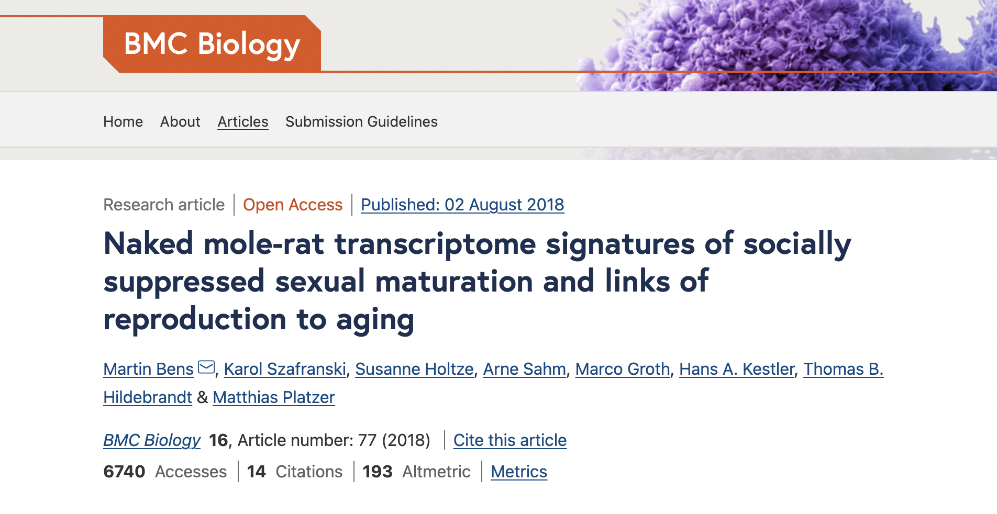
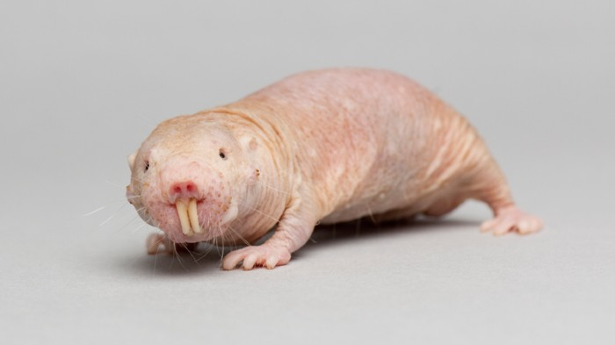
Background
Naked Mole Rat
Longevity
Cancer
Bens et al. (2018)
Comparative transcriptome analysis of breeders vs. non-breeders of NMR vs. Guinea Pig
Non-breeders sex differentiation low for naked mole-rat
After transition to breeders, the transcriptomes become remarkedly more sex-specific
https://www.nature.com/articles/d41586-018-06096-8

Slide 4
Data and Question
1. Are there differentially expressed genes in liver within naked mole rat population?
2. Will using different alignment tools significantly affect the results?
Data:
23 samples, 11 females, 12 males
Breeder and non-breeder status
2 analysis tools: STAR and HISAT2

Slide 5
Workflow
Ensembl download:
Fastq QC
Alignment: STAR / HISAT2
Alignment QC
ResQC
Feature Counts
DESeq Analysis
Heatmap
Volcano Plot
MA Plot
DE on Top genes

Slide 6
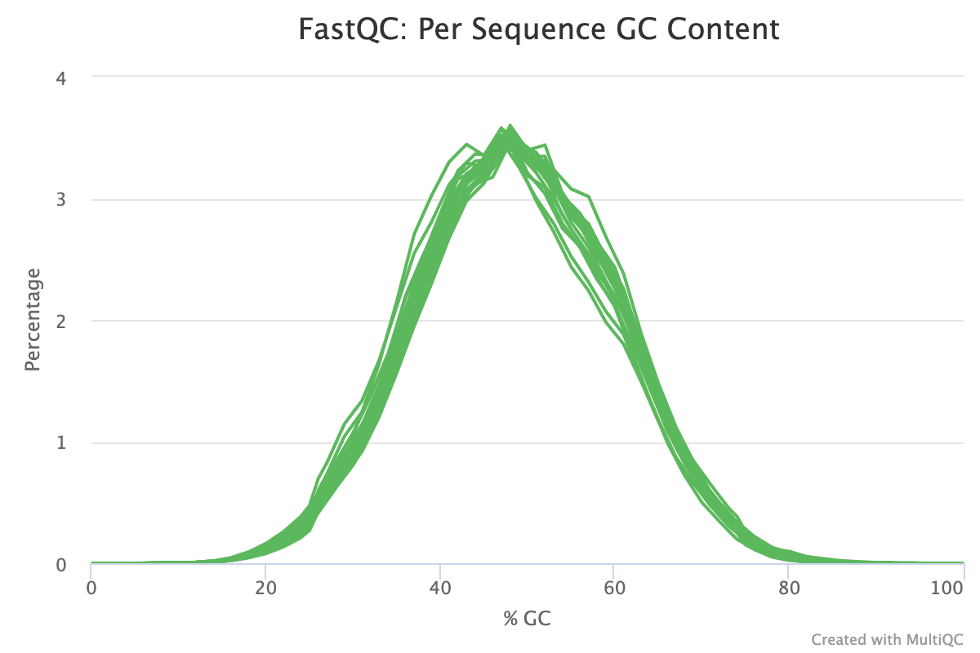
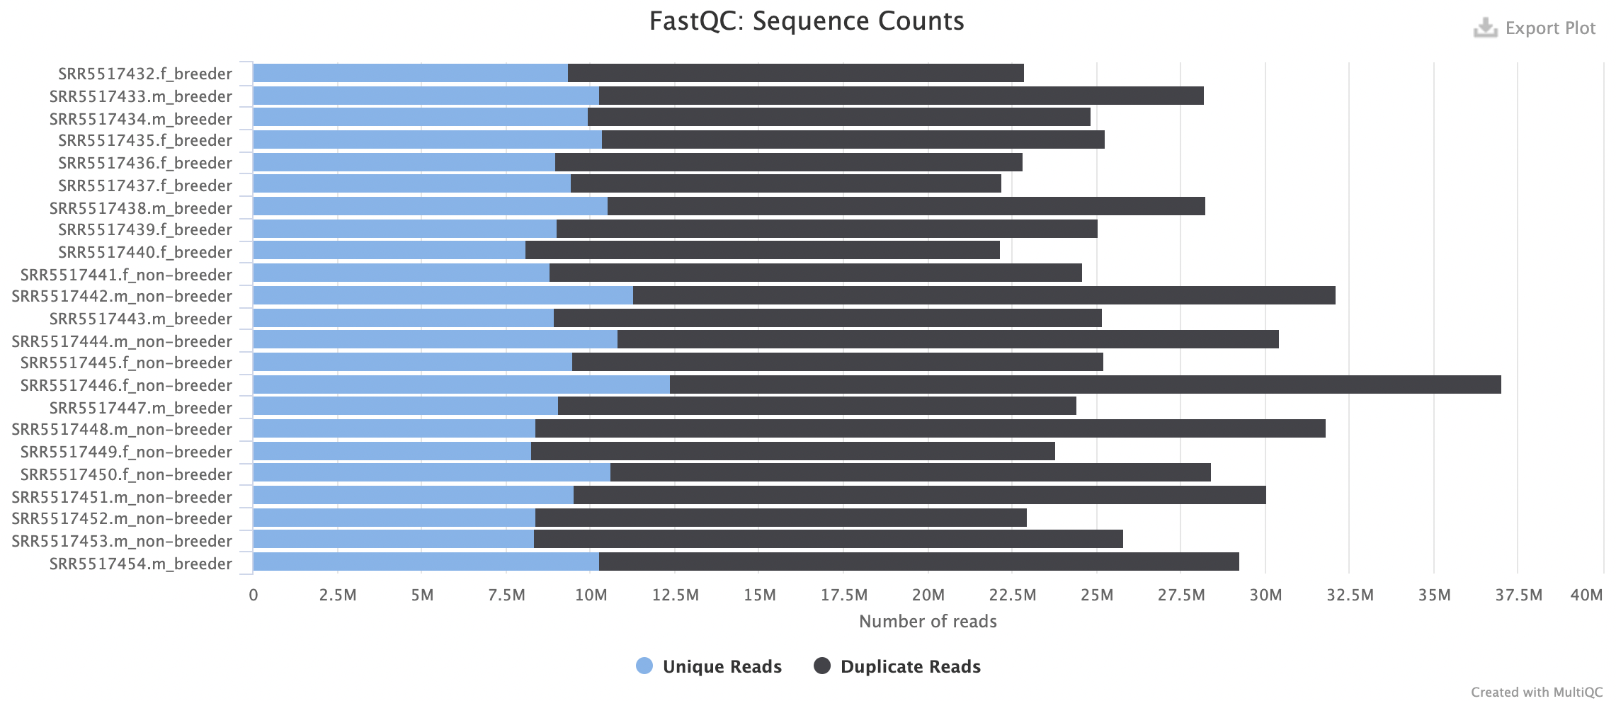
Results: FastQ Quality Checks
The sequences are nicely processed

Slide 7
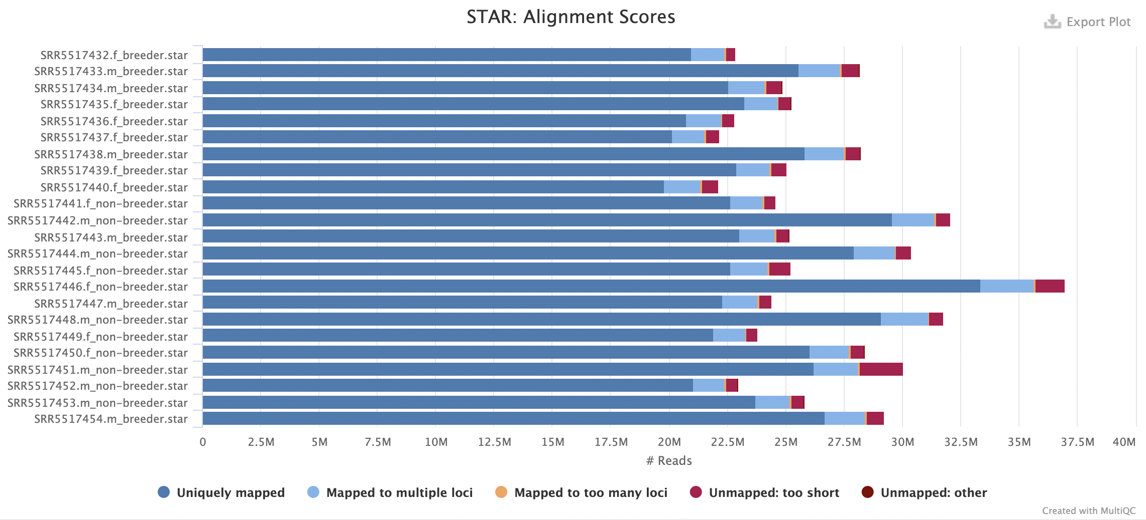
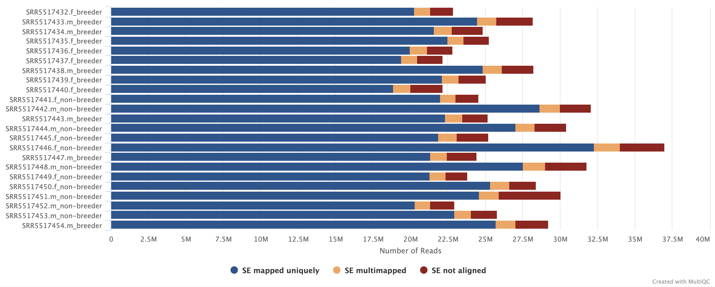
Results: Alignment Quality Check
Both has alignment score > 90%
HISAT2 Alignment Scores

Slide 8
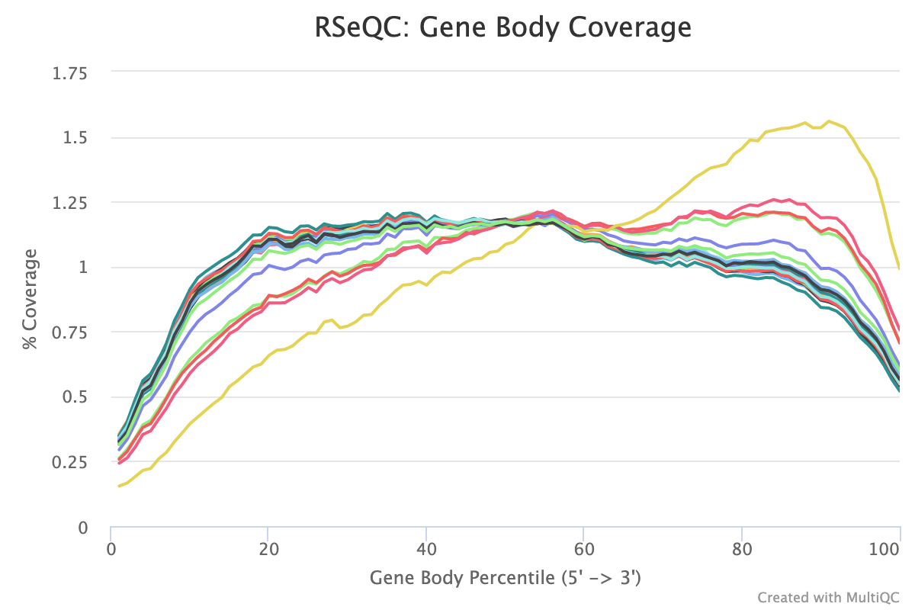
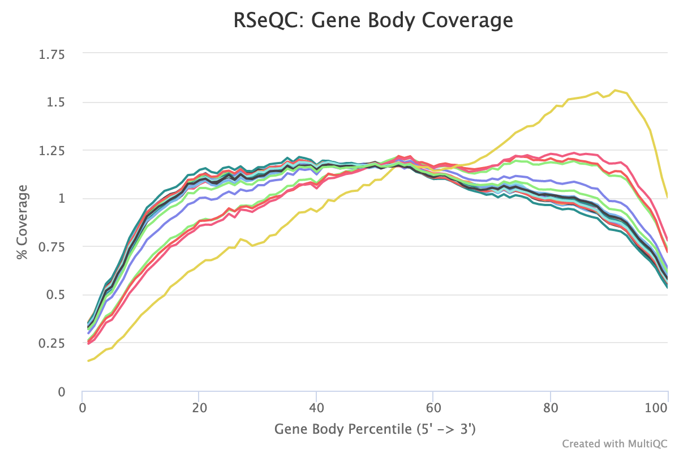
Results: Gene Body Coverage
Gene Body Coverage was uniform across the genome
STAR
HISAT2

Slide 9
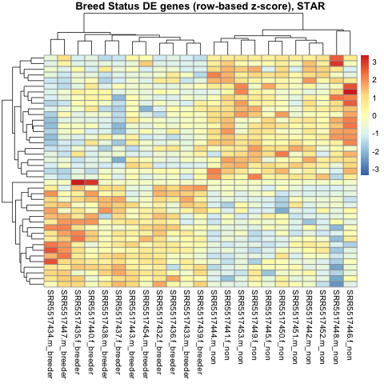
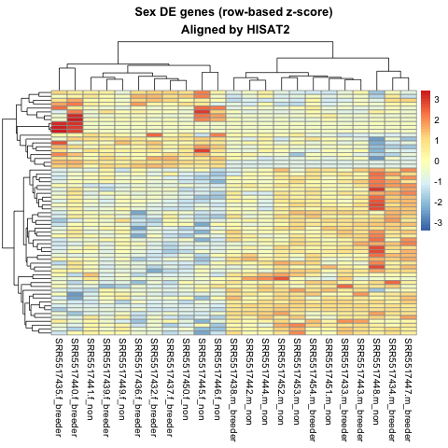
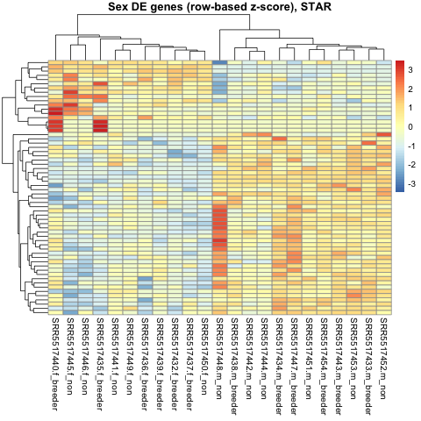
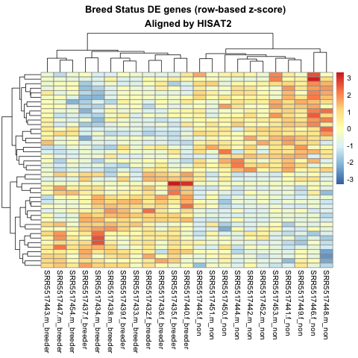
DE Results: HeatMap

Slide 10
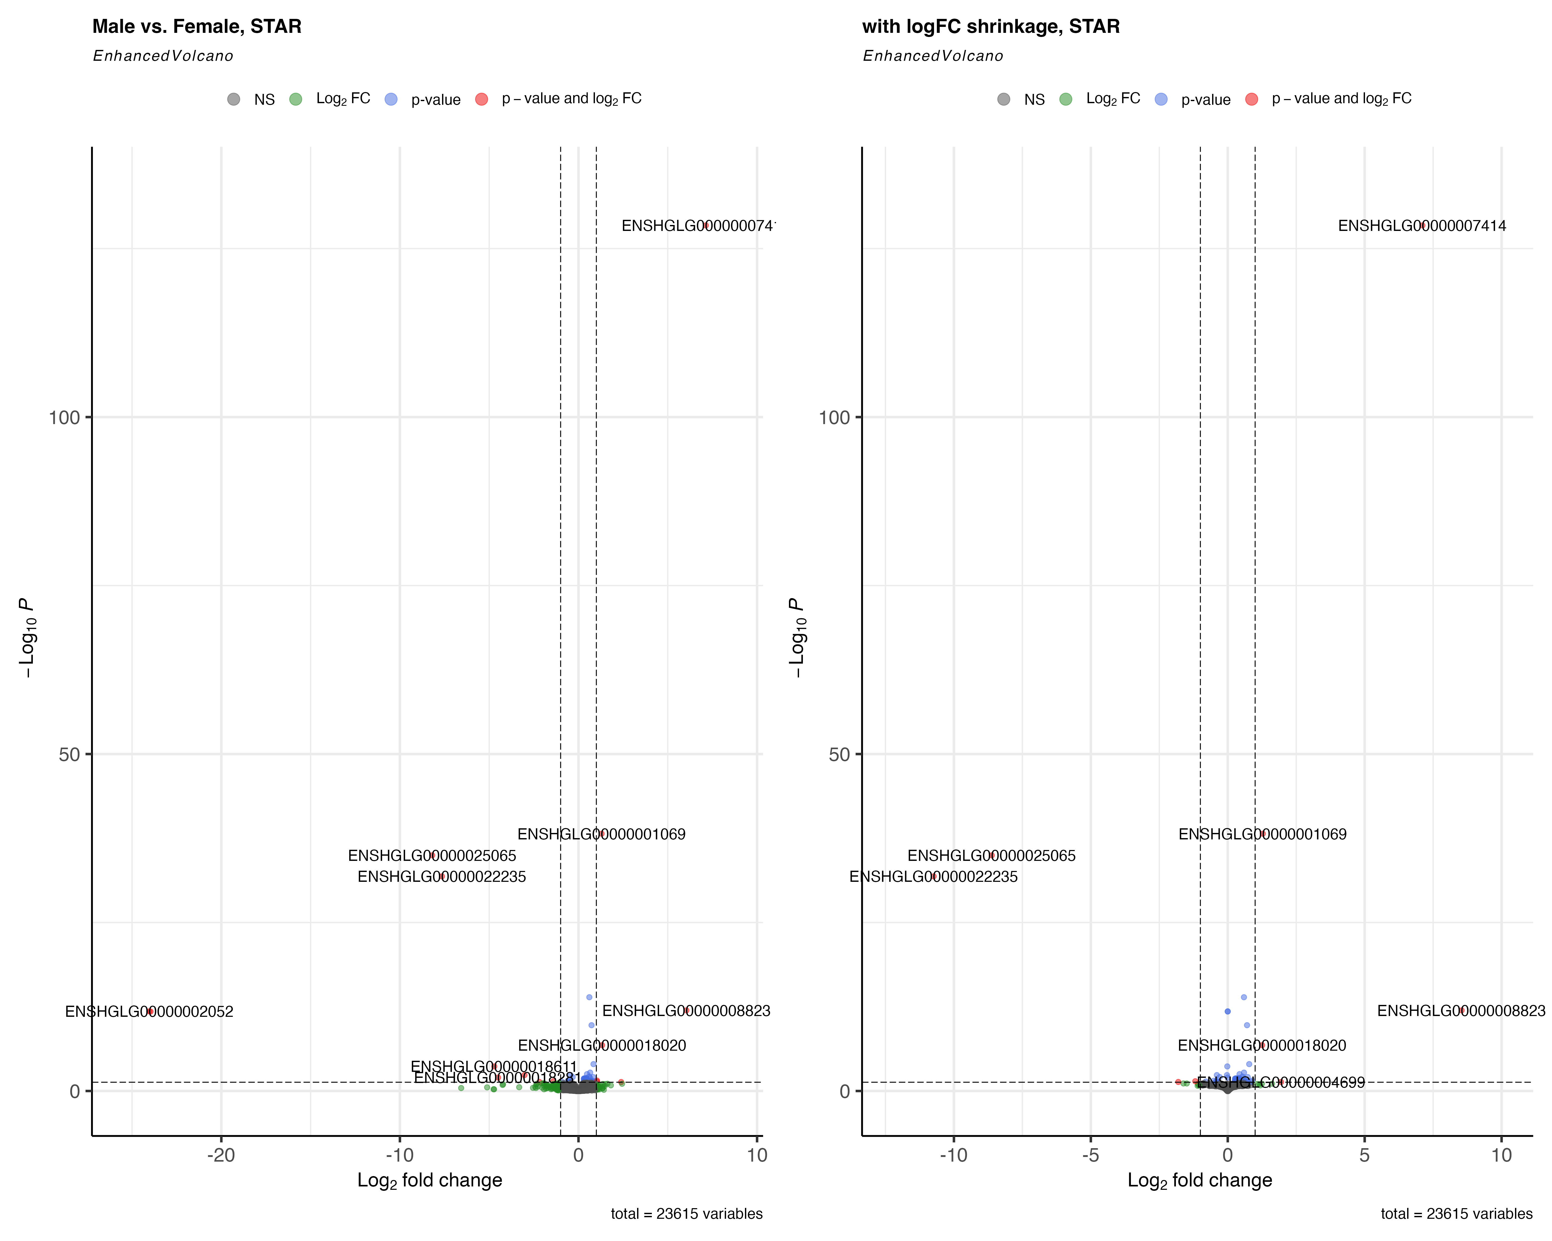
Volcano Plot: Sex (STAR)

Slide 11
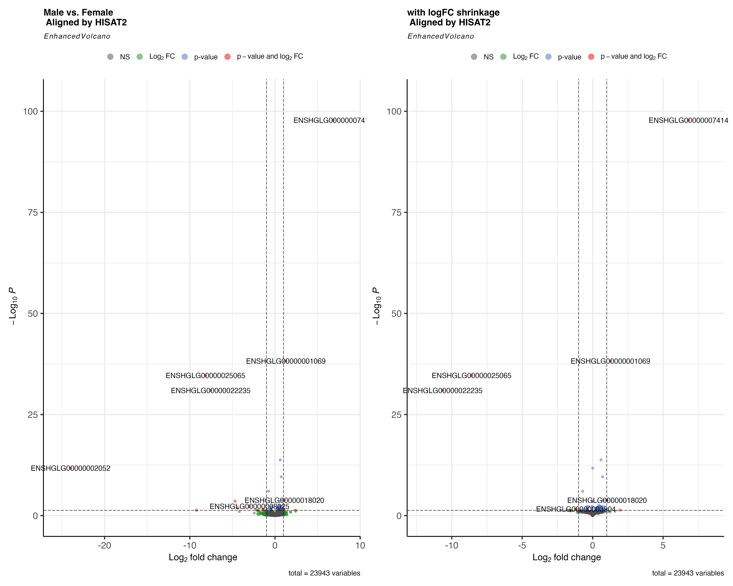
Volcano Plot: Sex (HISAT2)

Slide 12
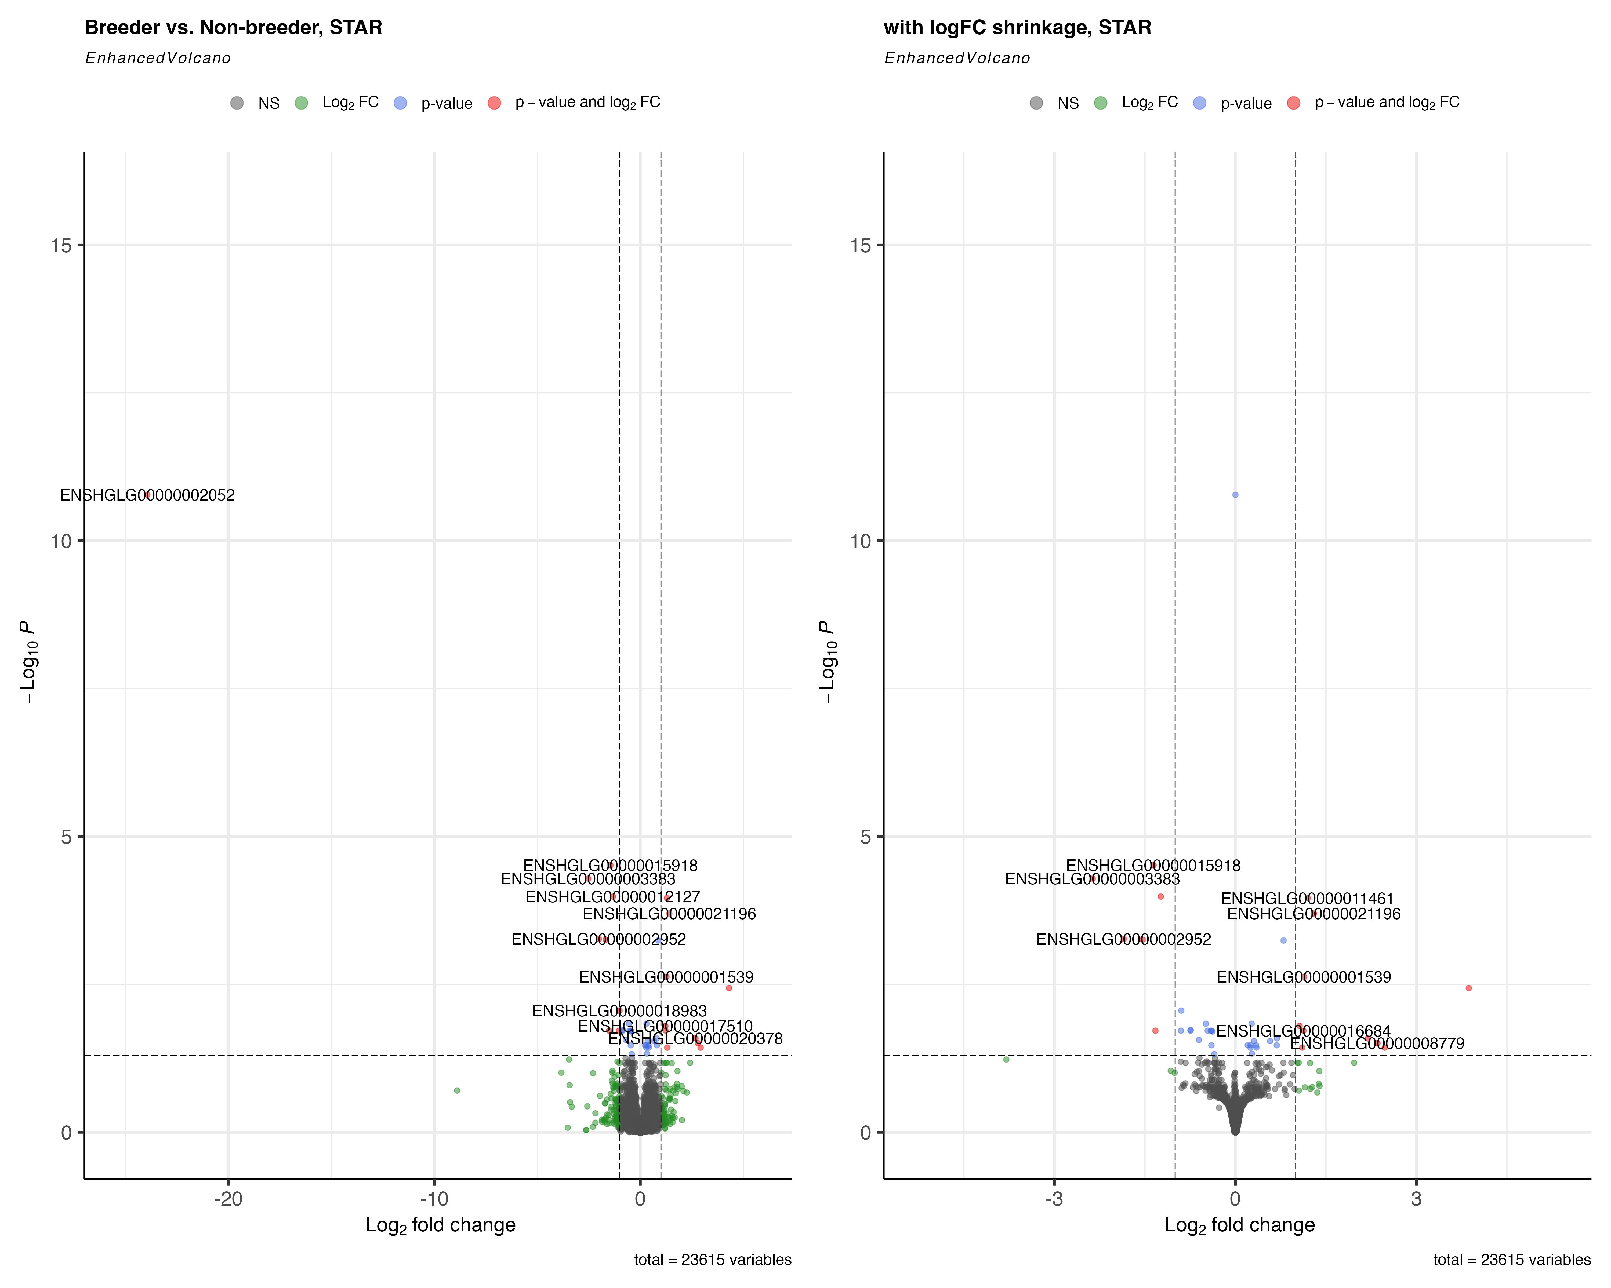
Volcano Plot: Breed (STAR)

Slide 13
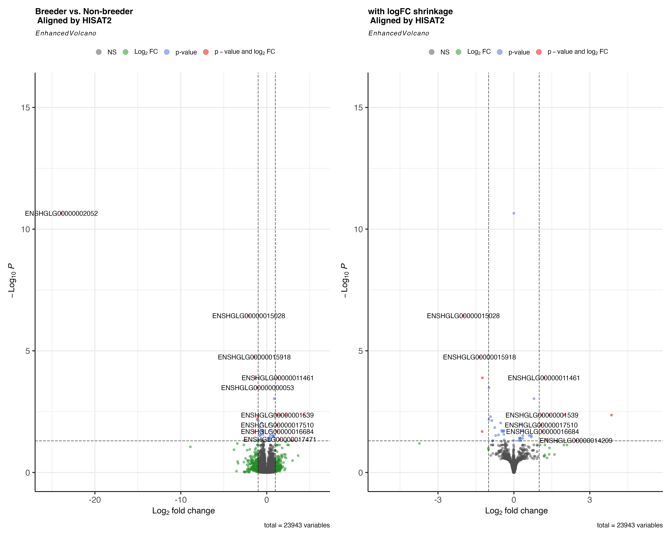
Volcano Plot: Breed (HISAT2)

Slide 14
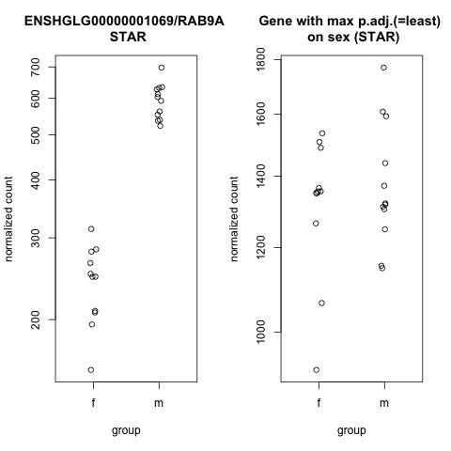
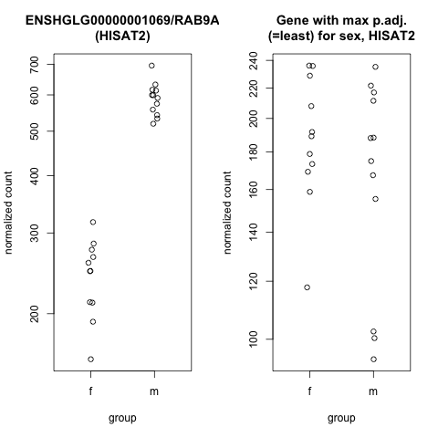
RAB9A DE Count : Sex
Notes:
enables GDP binding activity; GTP binding activity; and GTPase activity. Involved in negative regulation by host of symbiont catalytic activity; positive regulation of exocytosis; and regulation of protein localization.

Slide 15
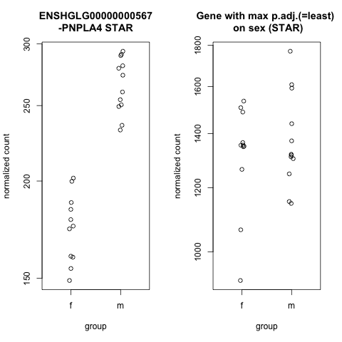
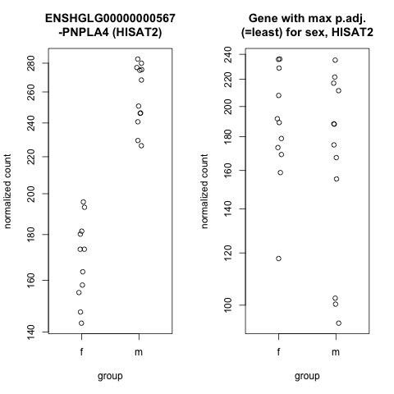
PNPLA4 DE Count: Sex
Notes:
encodes for an enzyme that has both triacylglycerol lipase and transacylase activities and may be involved in adipocyte triglyceride homeostasis.

Slide 16
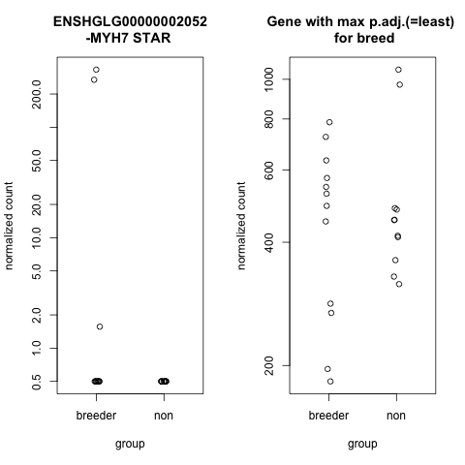
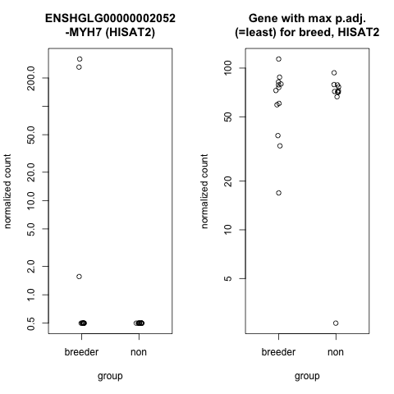
MYH7 DE Count: Breed
Notes:
encodes the beta (or slow) heavy chain subunit of cardiac myosin.

Slide 17
Conclusion
STAR vs. HISAT2
Female vs. Male
Non-breeder vs. Breeder
Limitations
Limit of source data
Gene referencing mess
Future Directions

Slide 18
References
1.Bens, M., Szafranski, K., Holtze, S., Sahm, A., Groth, M., Kestler, H. A., … & Platzer, M. (2018). Naked mole-rat transcriptome signatures of socially suppressed sexual maturation and links of reproduction to aging. BMC biology, 16(1), 1-13.
2.Kim, E. B., Fang, X., Fushan, A. A., Huang, Z., Lobanov, A. V., Han, L., … & Gladyshev, V. N. (2011). Genome sequencing reveals insights into physiology and longevity of the naked mole rat. Nature, 479(7372), 223-227.
3.Fang, X., Seim, I., Huang, Z., Gerashchenko, M., Xiong, Z., Turanov, A., … & Gladyshev, V. (2014). Adaptations to a subterranean environment and longevity revealed by the analysis of mole rat genomes. Cell reports, 8(5), 1354-1364.
4.Delsuc, F., & Tilak, M. K. (2015). Naked but not hairless: the pitfalls of analyses of molecular adaptation based on few genome sequence comparisons. Genome biology and evolution, 7(3), 768-774.

Slide 19
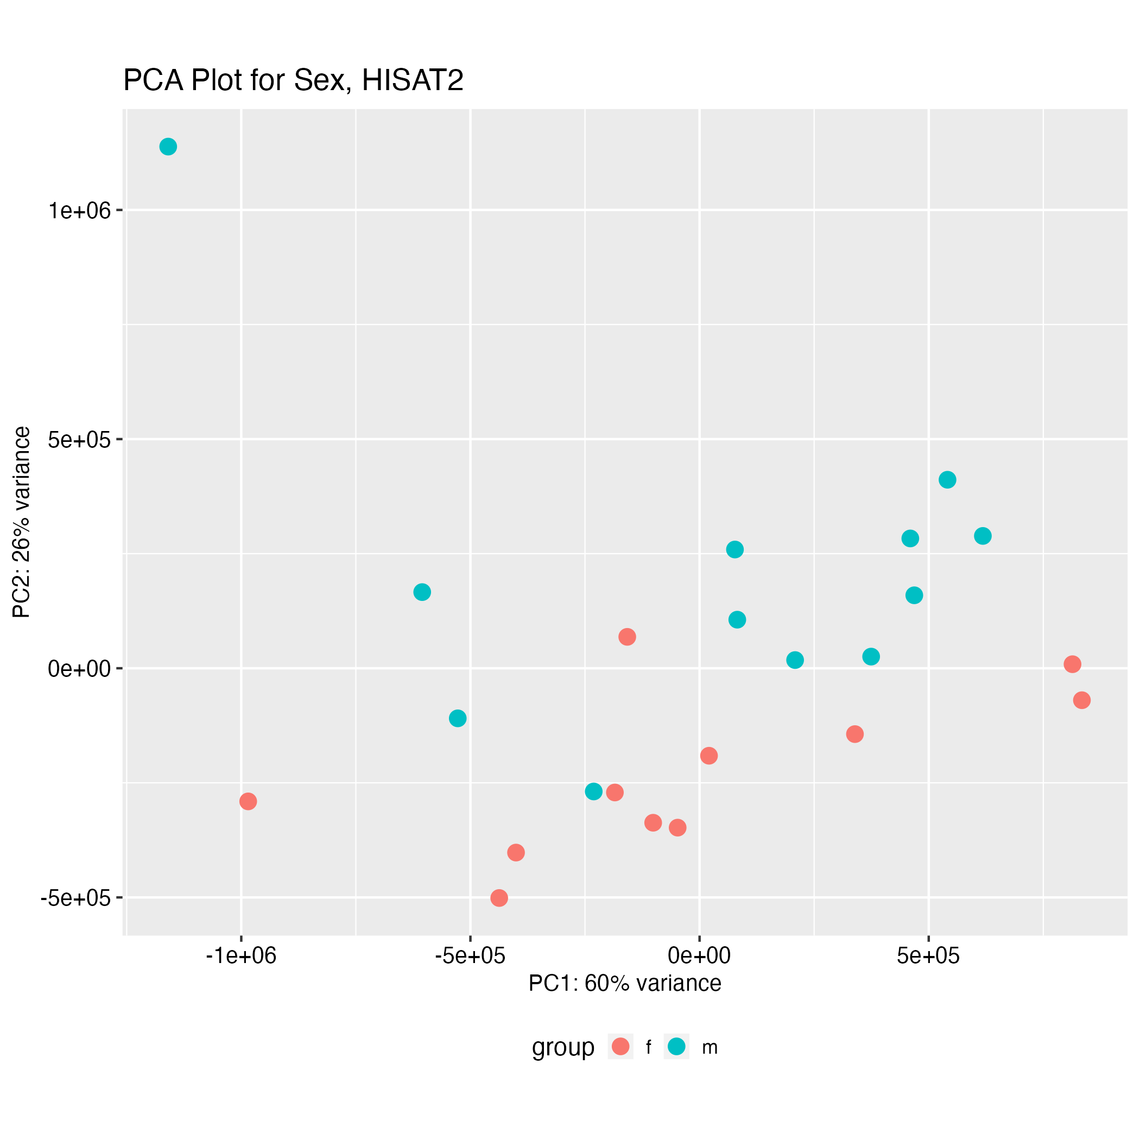
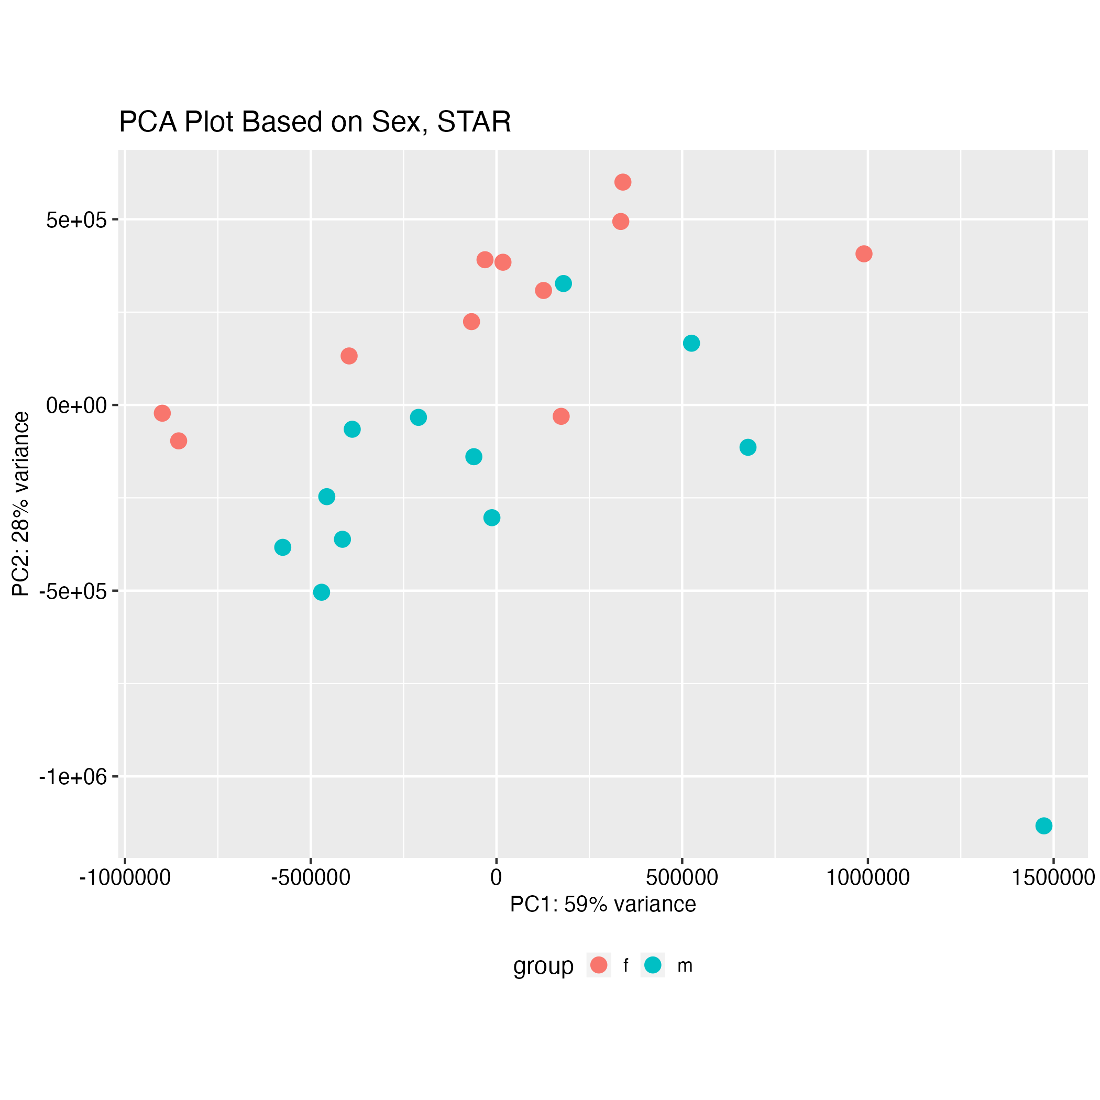
PCAs: Sex

Slide 20
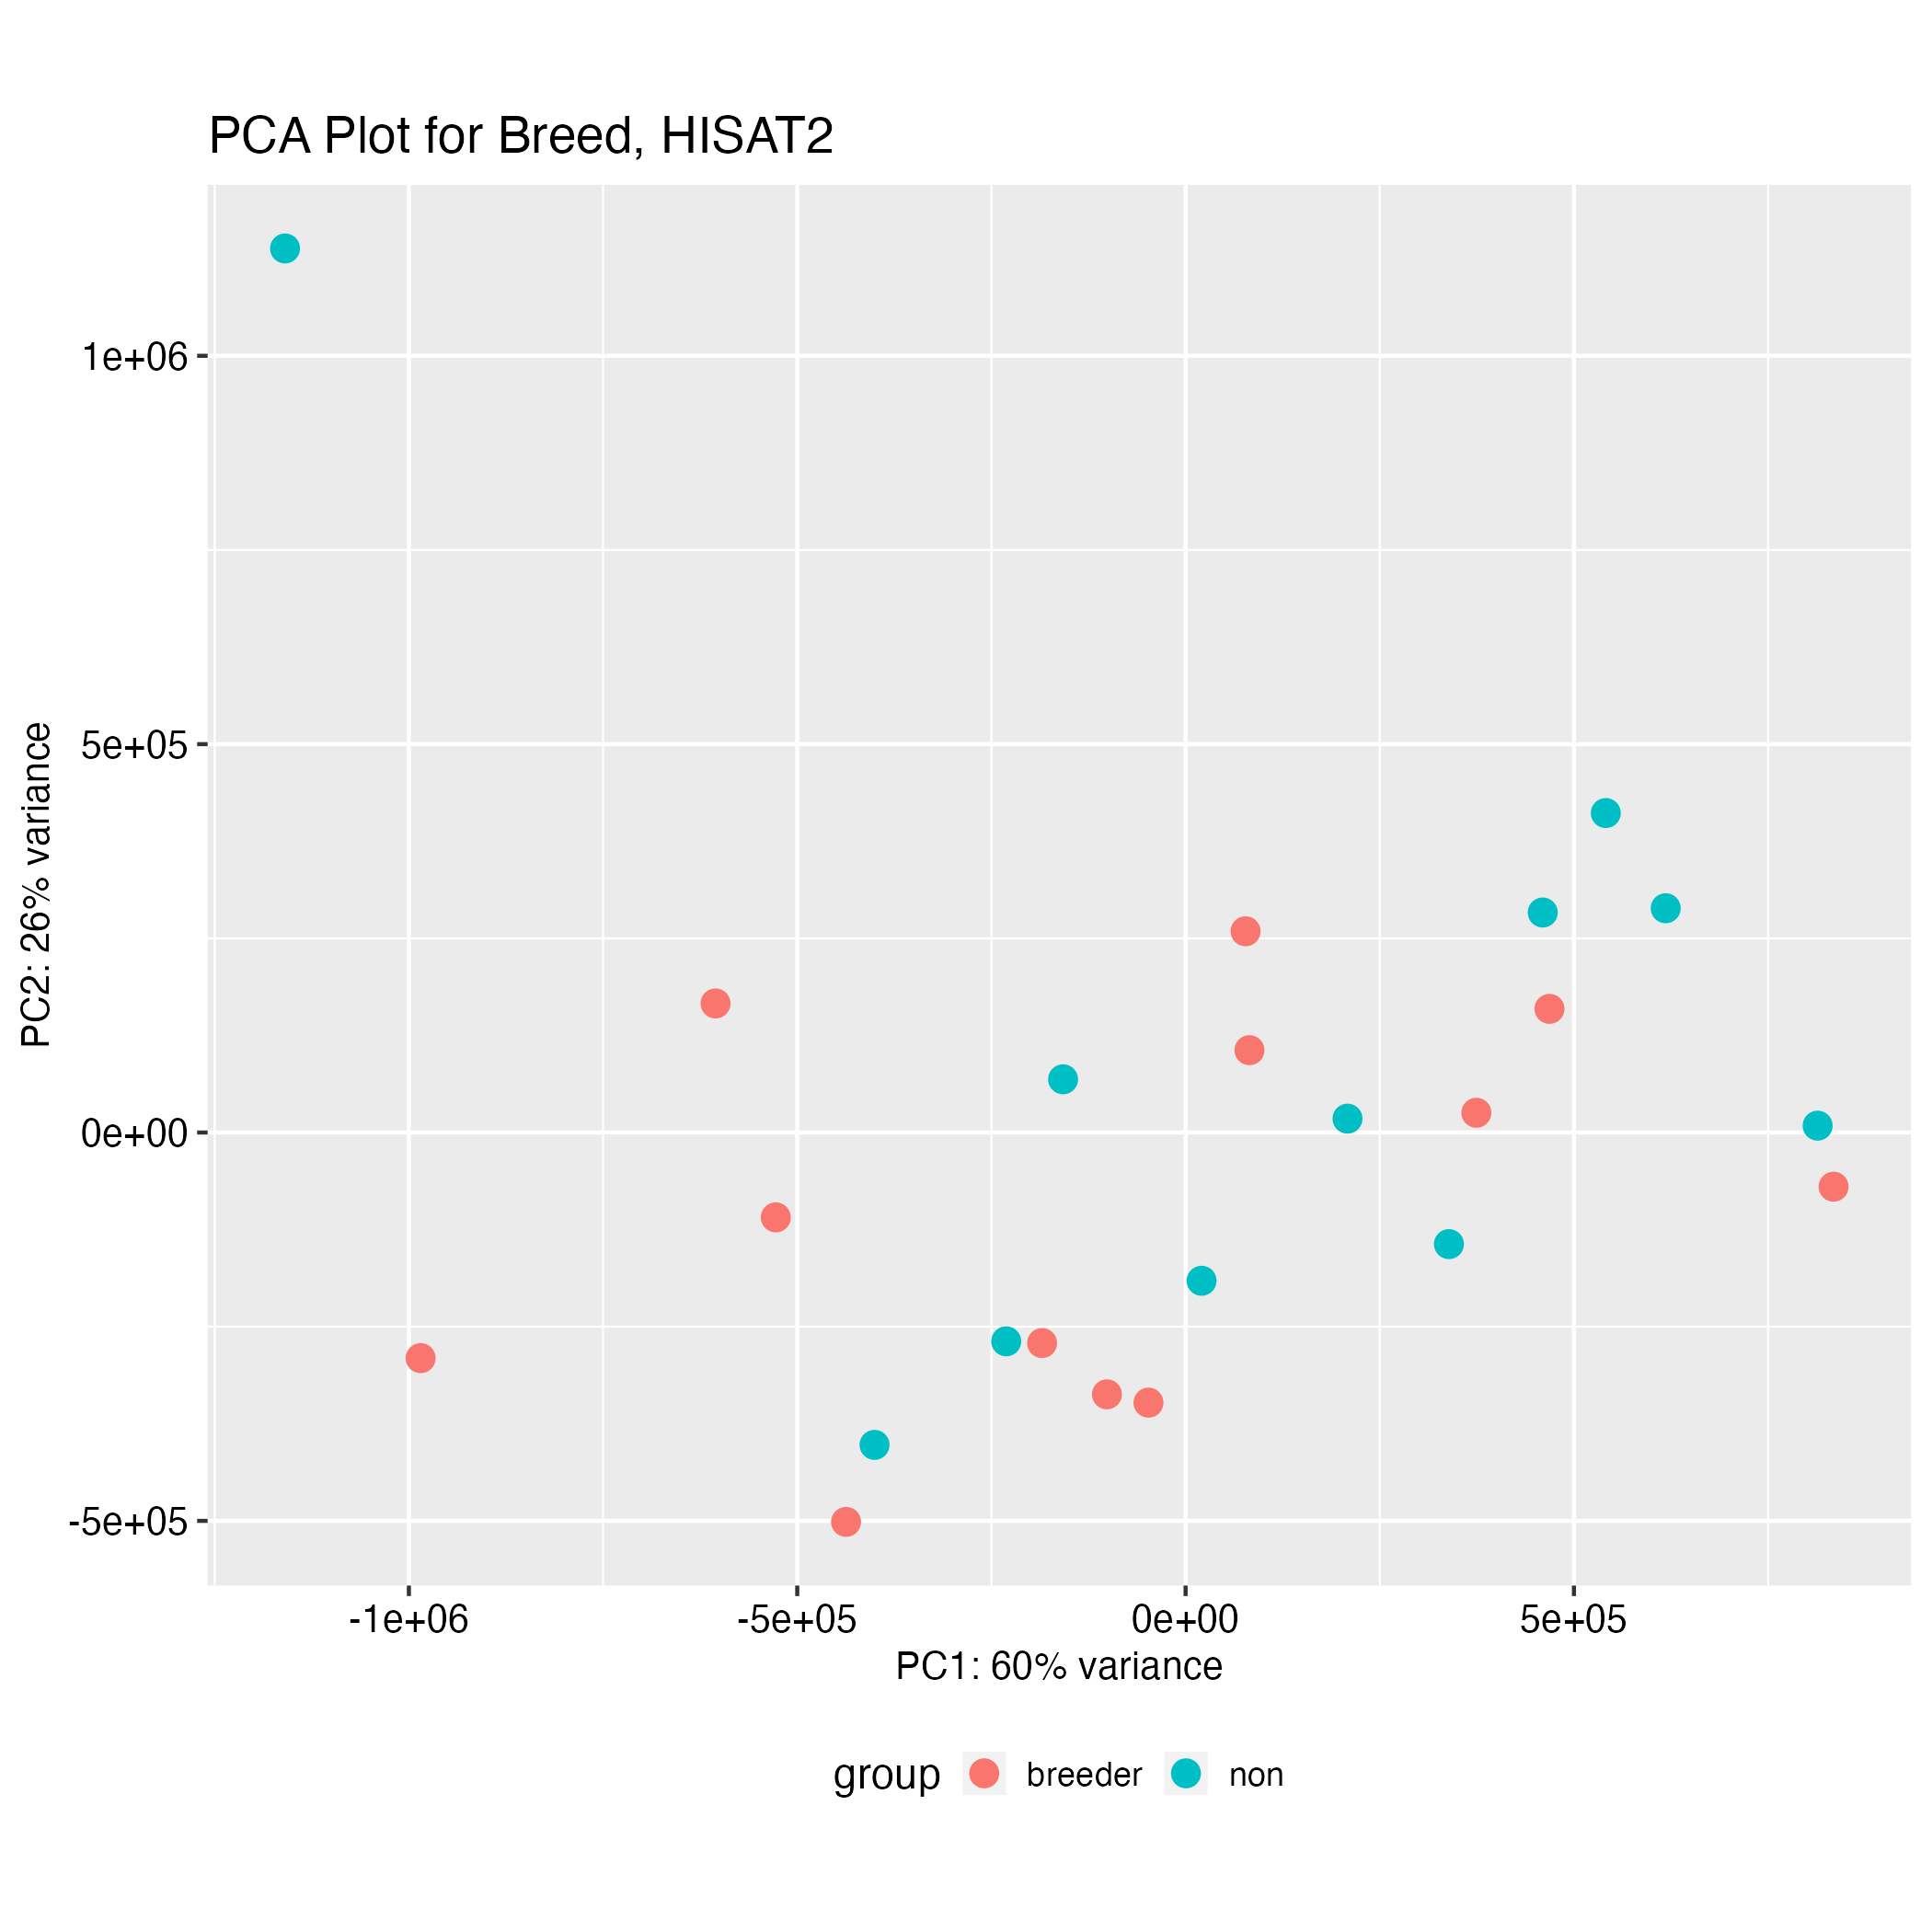
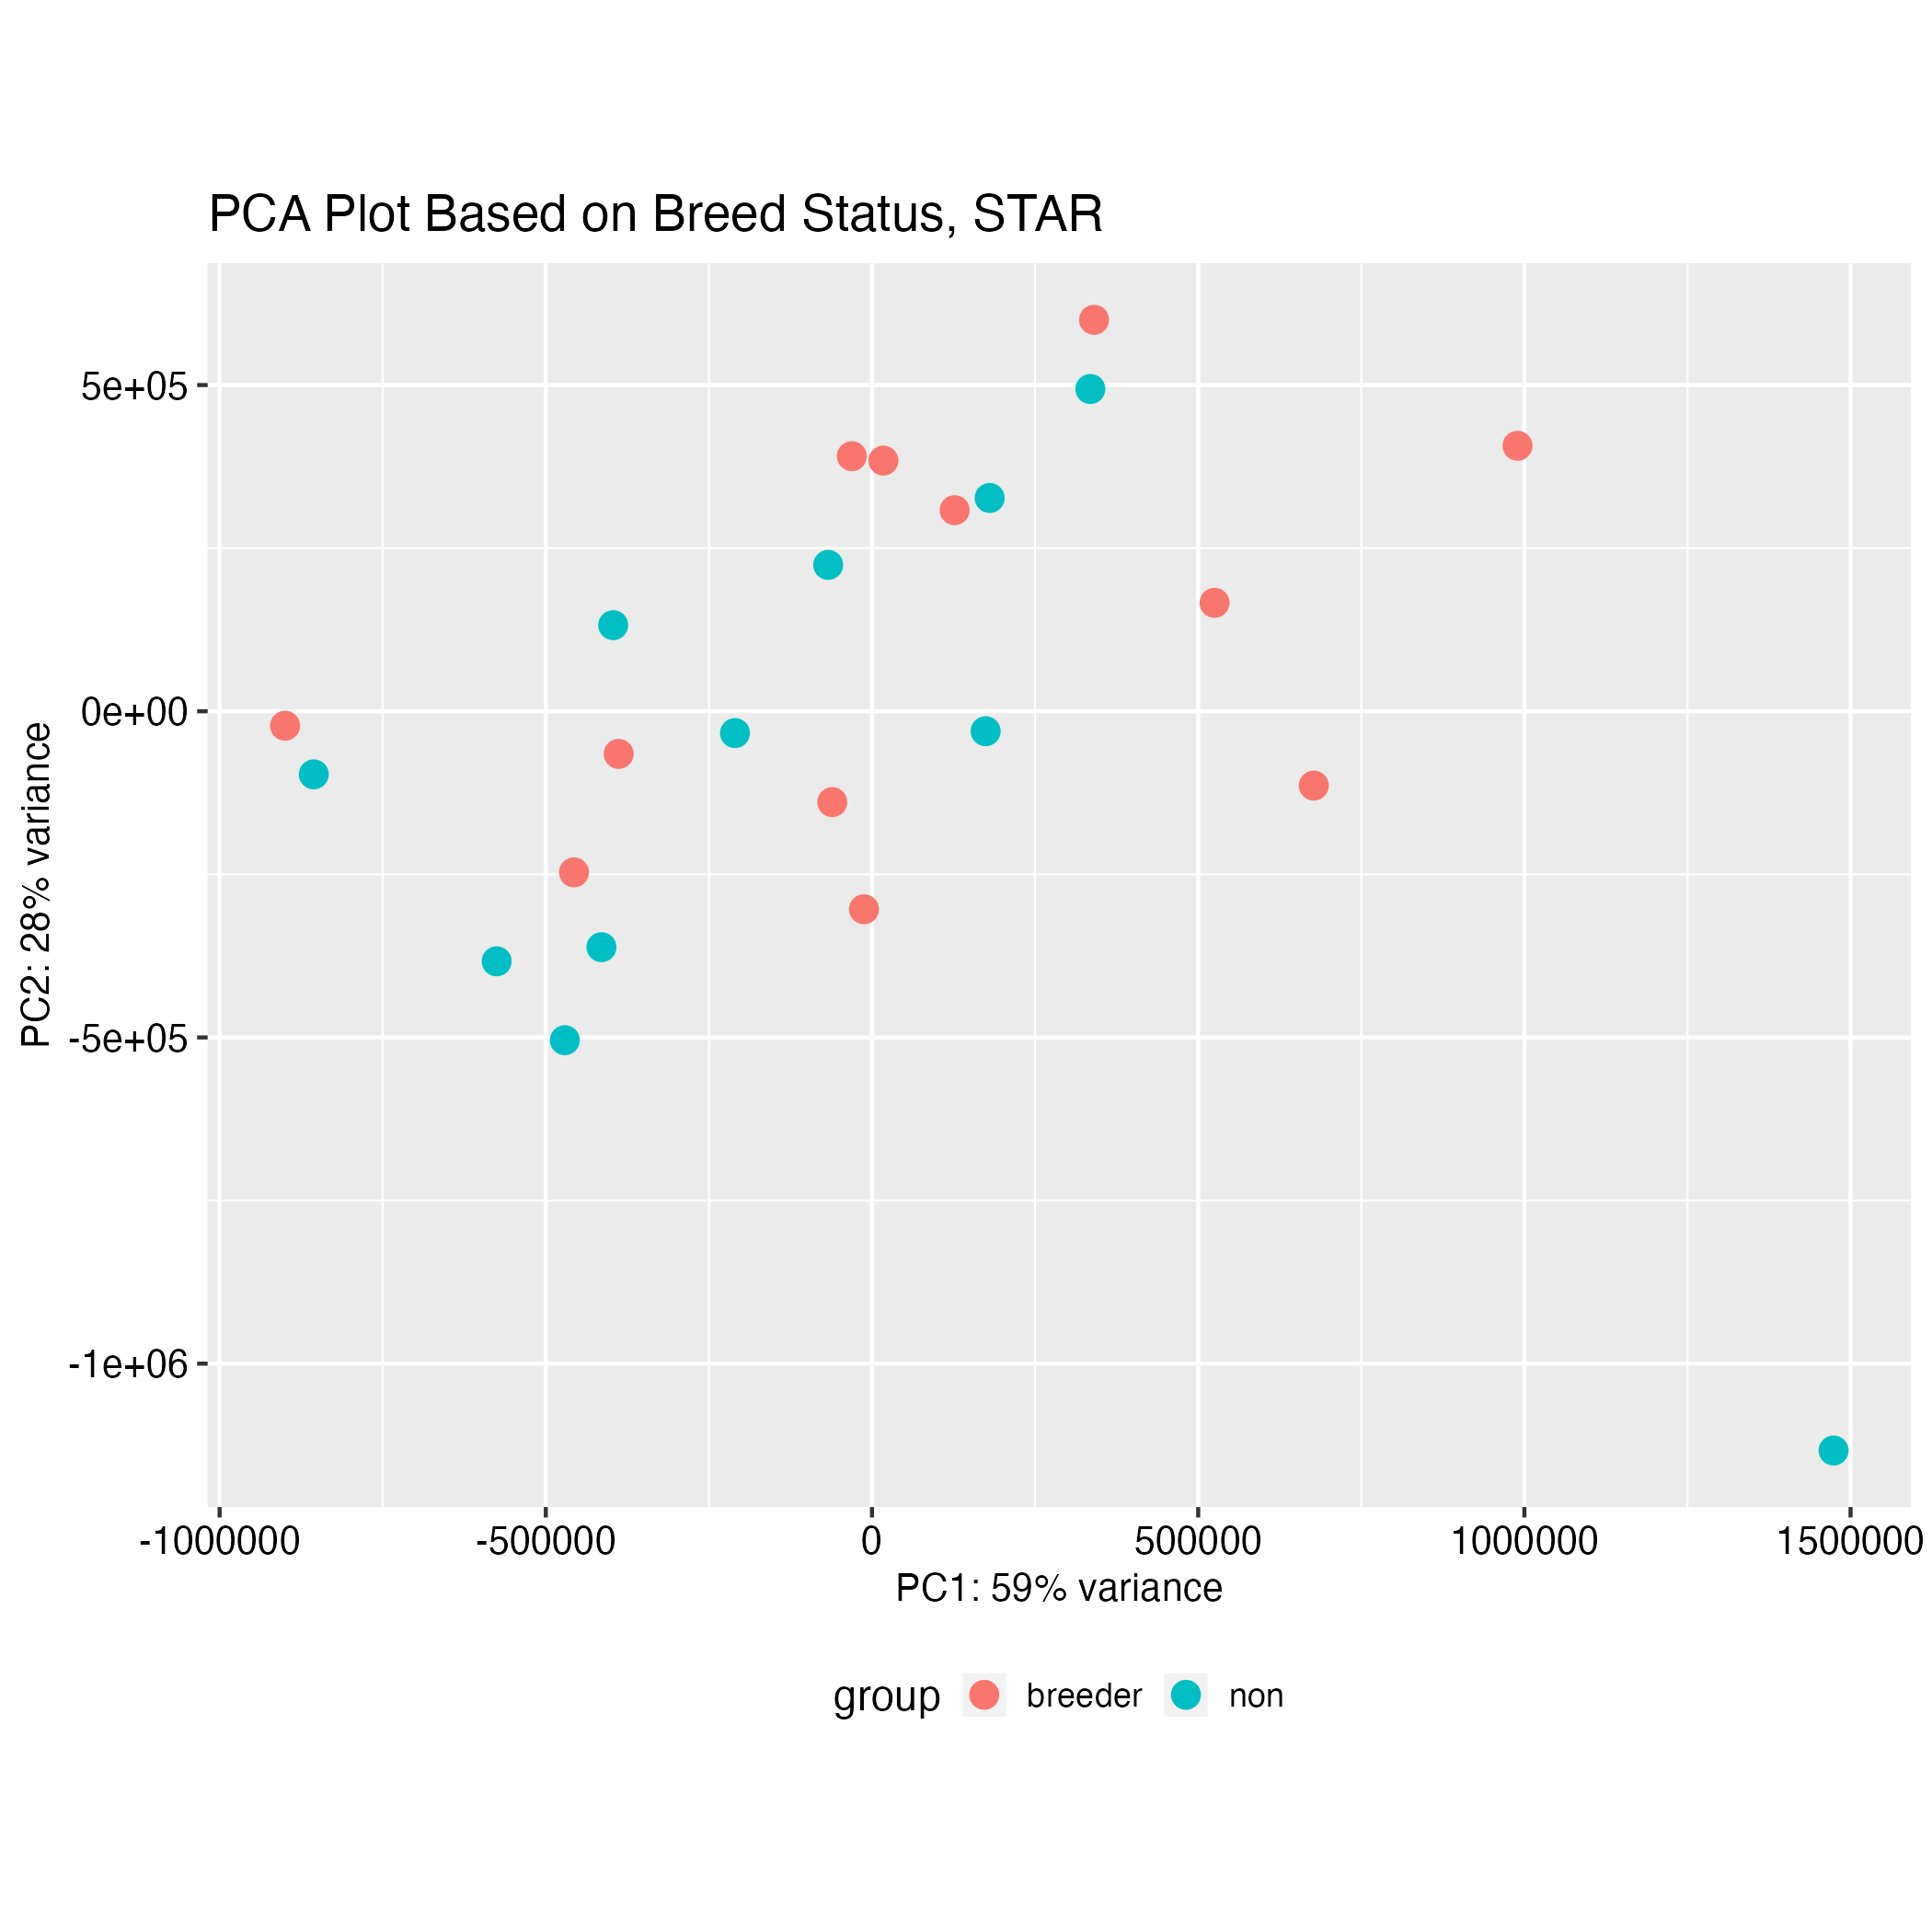
PCAs: Breed

Slide 21
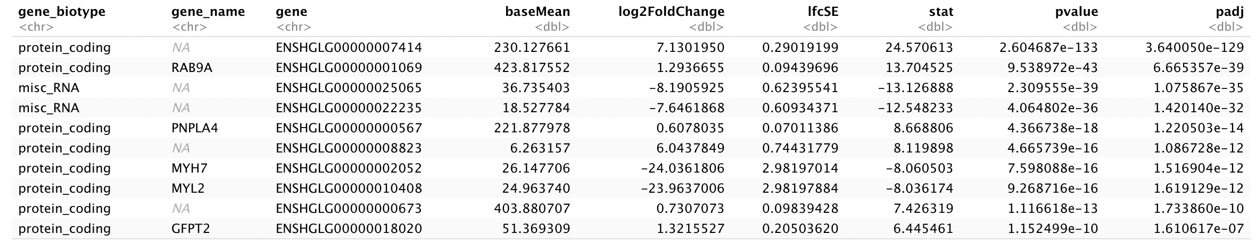
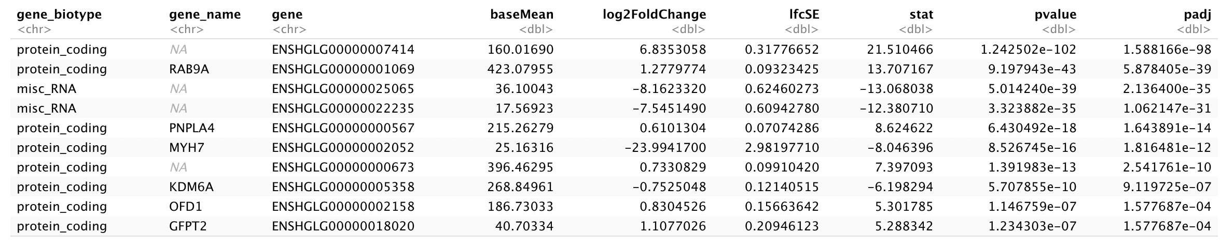
Top Genes Differentially Regulated: Sex
STAR
HISAT2

Slide 22
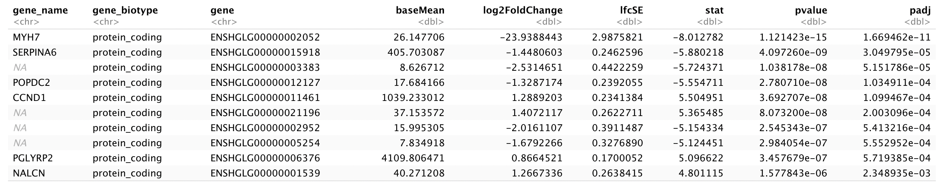
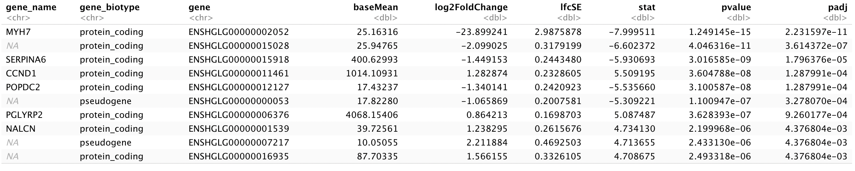
Top Genes: Breed Status
STAR
HISAT2

Slide 23
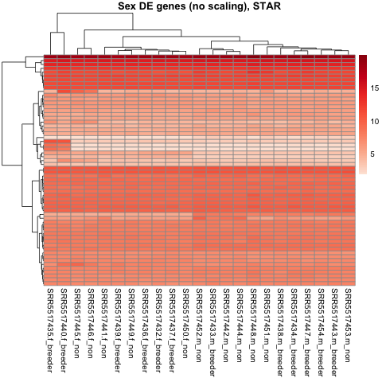
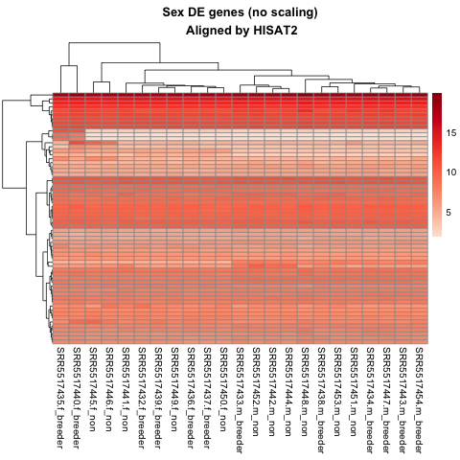
Heatmap Sex (No Scale)

Slide 24
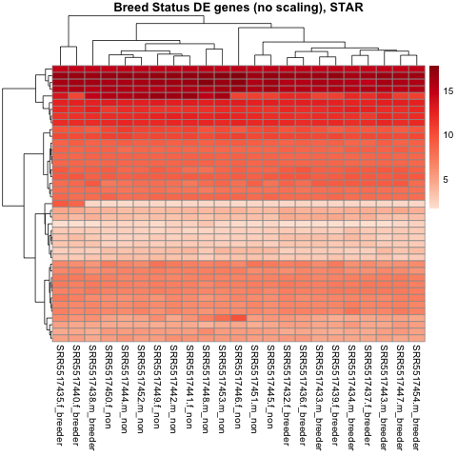
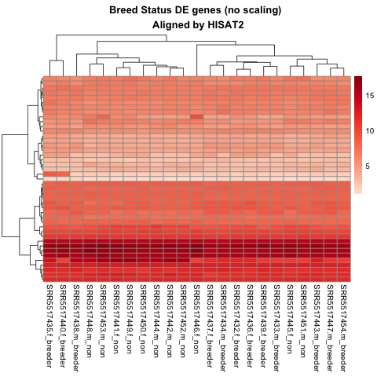
Heatmap Breed (No Scale)

Slide 25
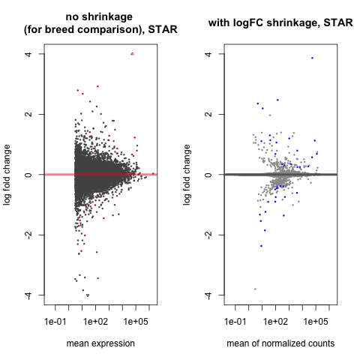
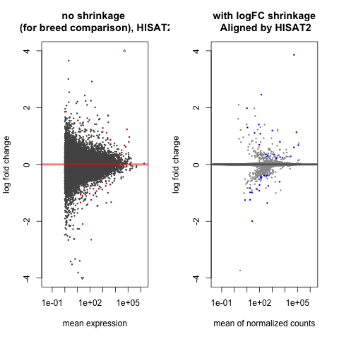
MA Plots (Sex)

Slide 26
MA Plot (Breed)

